Slide 1
Schriftartenerkennung mit CNN
Alexander Taubert

Slide 2
Schriftartenerkennung mit CNN
Bilderformat 1200 x 40 x 3 (w x h x c)
Labels 1-12 (Schriftarten)
Arial
Calibri
Canterbury
Comic_san_ms
Courier_new
Forte
Jokerman
Monofont
Times_new_roman
Times_new_romance
Unispace_rg
Waltograph_ui

Slide 3
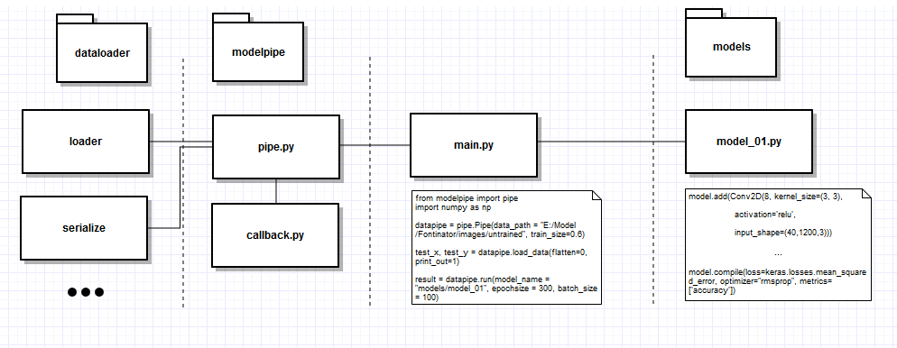
Schriftartenerkennung mit CNN

Slide 4
Schriftartenerkennung mit CNN

Slide 5
Schriftartenerkennung mit CNN – Model 1
model.add(Conv2D(8, kernel_size=(3, 3), activation='relu‘, input_shape=(40,1200,3)))
model.add(MaxPooling2D(pool_size=(2, 2)))
model.add(Conv2D(16, kernel_size=(3, 3), activation='relu'))
model.add(MaxPooling2D(pool_size=(2, 2)))
model.add(Conv2D(24, kernel_size=(3, 3), activation='sigmoid'))
model.add(MaxPooling2D(pool_size=(2, 2)))
model.add(Dropout(0.2))
model.add(Flatten())
model.add(Dense(256, activation='relu'))
model.add(Dropout(0.4))
model.add(Dense(len(classes), activation='softmax'))
model.compile(loss=keras.losses.mean_squared_error, optimizer="rmsprop", metrics=['accuracy'])

Slide 6
Schriftartenerkennung mit CNN – Model 2
model.add(Conv2D(8, kernel_size=(4, 4), activation='relu‘, input_shape=(40,1200,3)))
model.add(MaxPooling2D(pool_size=(2, 2)))
model.add(Conv2D(16, kernel_size=(3, 3), activation='relu'))
model.add(MaxPooling2D(pool_size=(2, 2)))
model.add(Conv2D(24, kernel_size=(3, 3), activation='sigmoid'))
model.add(MaxPooling2D(pool_size=(2, 2)))
model.add(Dropout(0.2))
model.add(Flatten())
model.add(Dense(256, activation='relu'))
model.add(Dropout(0.4))
model.add(Dense(len(classes), activation='softmax'))
model.compile(loss=keras.losses.mean_squared_error, optimizer="rmsprop", metrics=['accuracy'])

Slide 7
Schriftartenerkennung mit CNN – Model 3
model.add(Conv2D(8, kernel_size=(7, 7), activation='relu‘, input_shape=(40,1200,3)))
model.add(MaxPooling2D(pool_size=(2, 2)))
model.add(Conv2D(16, kernel_size=(3, 3), activation='relu'))
model.add(MaxPooling2D(pool_size=(2, 2)))
model.add(Conv2D(24, kernel_size=(3, 3), activation='sigmoid'))
model.add(MaxPooling2D(pool_size=(2, 2)))
model.add(Dropout(0.2))
model.add(Flatten())
model.add(Dense(256, activation='relu'))
model.add(Dropout(0.4))
model.add(Dense(len(classes), activation='softmax'))
model.compile(loss=keras.losses.mean_squared_error, optimizer="rmsprop", metrics=['accuracy'])

Slide 8
Schriftartenerkennung mit CNN – Model 4
model.add(Conv2D(8, kernel_size=(9, 9), activation='relu‘, input_shape=(40,1200,3)))
model.add(MaxPooling2D(pool_size=(2, 2)))
model.add(Conv2D(16, kernel_size=(3, 3), activation='relu'))
model.add(MaxPooling2D(pool_size=(2, 2)))
model.add(Conv2D(24, kernel_size=(3, 3), activation='sigmoid'))
model.add(MaxPooling2D(pool_size=(2, 2)))
model.add(Dropout(0.2))
model.add(Flatten())
model.add(Dense(256, activation='relu'))
model.add(Dropout(0.4))
model.add(Dense(len(classes), activation='softmax'))
model.compile(loss=keras.losses.mean_squared_error, optimizer="rmsprop", metrics=['accuracy'])

Slide 9
Schriftartenerkennung mit CNN – Model 5
model.add(Conv2D(8, kernel_size=(4, 4), activation='relu‘, input_shape=(40,1200,3)))
model.add(MaxPooling2D(pool_size=(2, 2)))
model.add(Conv2D(16, kernel_size=(3, 3), activation='relu'))
model.add(MaxPooling2D(pool_size=(2, 2)))
model.add(Conv2D(24, kernel_size=(3, 3), activation='sigmoid‘))
#model.add(MaxPooling2D(pool_size=(2, 2)))
#model.add(Dropout(0.2))
model.add(Flatten())
model.add(Dense(256, activation='relu'))
model.add(Dropout(0.4))
model.add(Dense(len(classes), activation='softmax'))
model.compile(loss=keras.losses.mean_squared_error, optimizer="rmsprop", metrics=['accuracy'])

Slide 10
Schriftartenerkennung mit CNN – Model 6
model.add(Conv2D(8, kernel_size=(7, 7), activation='relu‘, input_shape=(40,1200,3)))
model.add(MaxPooling2D(pool_size=(2, 2)))
model.add(Conv2D(16, kernel_size=(3, 3), activation='relu'))
model.add(MaxPooling2D(pool_size=(2, 2)))
model.add(Conv2D(24, kernel_size=(3, 3), activation='sigmoid‘))
#model.add(MaxPooling2D(pool_size=(2, 2)))
#model.add(Dropout(0.2))
model.add(Flatten())
model.add(Dense(256, activation='relu'))
model.add(Dropout(0.4))
model.add(Dense(len(classes), activation='softmax'))
model.compile(loss=keras.losses.mean_squared_error, optimizer="rmsprop", metrics=['accuracy'])

Slide 11
Schriftartenerkennung mit CNN – Model 7
model.add(Conv2D(8, kernel_size=(4, 4), activation='relu‘, input_shape=(40,1200,3)))
model.add(MaxPooling2D(pool_size=(2, 2)))
model.add(Conv2D(16, kernel_size=(3, 3), activation='relu'))
model.add(MaxPooling2D(pool_size=(2, 2)))
#model.add(Conv2D(24, kernel_size=(3, 3), activation='sigmoid‘))
#model.add(MaxPooling2D(pool_size=(2, 2)))
model.add(Dropout(0.2))
model.add(Flatten())
model.add(Dense(256, activation='relu'))
model.add(Dropout(0.4))
model.add(Dense(len(classes), activation='softmax'))
model.compile(loss=keras.losses.mean_squared_error, optimizer="rmsprop", metrics=['accuracy'])

Slide 12
Schriftartenerkennung mit CNN – Model 8
model.add(Conv2D(8, kernel_size=(7, 7), activation='relu‘, input_shape=(40,1200,3)))
model.add(MaxPooling2D(pool_size=(2, 2)))
model.add(Conv2D(16, kernel_size=(3, 3), activation='relu'))
model.add(MaxPooling2D(pool_size=(2, 2)))
#model.add(Conv2D(24, kernel_size=(3, 3), activation='sigmoid‘))
#model.add(MaxPooling2D(pool_size=(2, 2)))
model.add(Dropout(0.2))
model.add(Flatten())
model.add(Dense(256, activation='relu'))
model.add(Dropout(0.4))
model.add(Dense(len(classes), activation='softmax'))
model.compile(loss=keras.losses.mean_squared_error, optimizer="rmsprop", metrics=['accuracy'])

Slide 13
Schriftartenerkennung mit CNN – Model 9
model.add(Conv2D(8, kernel_size=(4, 4), activation='relu‘, input_shape=(40,1200,3)))
model.add(MaxPooling2D(pool_size=(2, 2)))
model.add(Conv2D(16, kernel_size=(3, 3), activation='relu'))
model.add(MaxPooling2D(pool_size=(2, 2)))
model.add(Conv2D(24, kernel_size=(3, 3), activation='sigmoid‘))
model.add(MaxPooling2D(pool_size=(2, 2)))
model.add(Dropout(0.4))
model.add(Flatten())
#model.add(Dense(256, activation='relu‘))
#model.add(Dropout(0.4))
model.add(Dense(len(classes), activation='softmax'))
model.compile(loss=keras.losses.mean_squared_error, optimizer="rmsprop", metrics=['accuracy'])

Slide 14
Schriftartenerkennung mit CNN – Model 10
model.add(Conv2D(8, kernel_size=(7, 7), activation='relu‘, input_shape=(40,1200,3)))
model.add(MaxPooling2D(pool_size=(2, 2)))
model.add(Conv2D(16, kernel_size=(3, 3), activation='relu'))
model.add(MaxPooling2D(pool_size=(2, 2)))
model.add(Conv2D(24, kernel_size=(3, 3), activation='sigmoid‘))
model.add(MaxPooling2D(pool_size=(2, 2)))
model.add(Dropout(0.4))
model.add(Flatten())
#model.add(Dense(256, activation='relu‘))
#model.add(Dropout(0.4))
model.add(Dense(len(classes), activation='softmax'))
model.compile(loss=keras.losses.mean_squared_error, optimizer="rmsprop", metrics=['accuracy'])

Slide 15
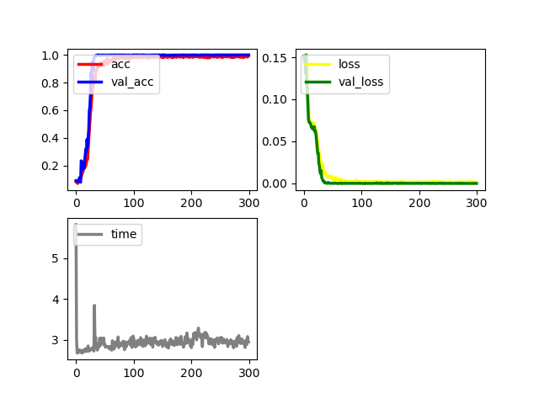
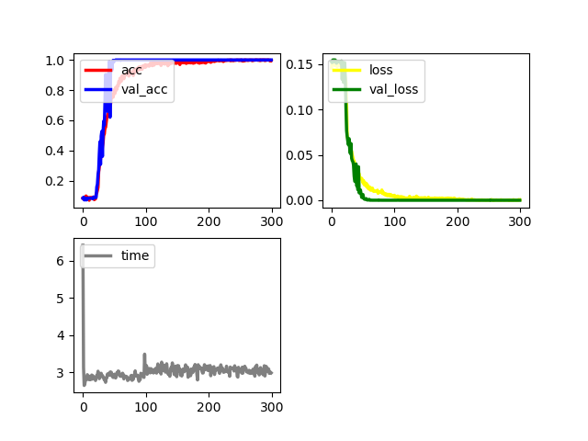
Schriftartenerkennung mit CNN
Model 1
Model 2

Slide 16
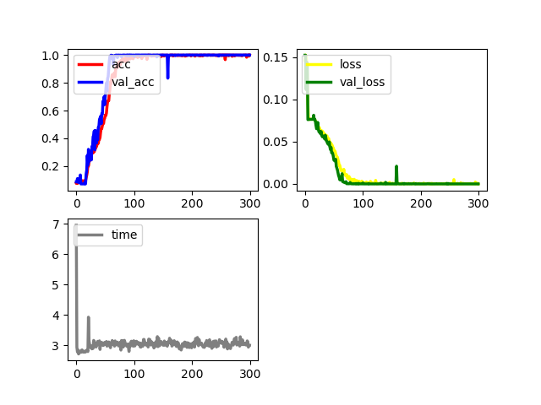
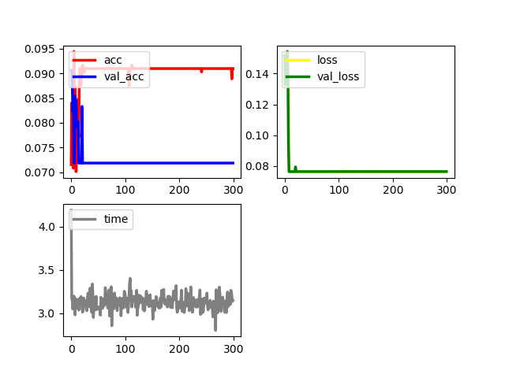
Schriftartenerkennung mit CNN
Model 3
Model 4

Slide 17
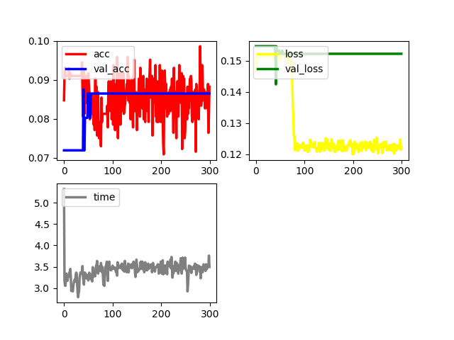
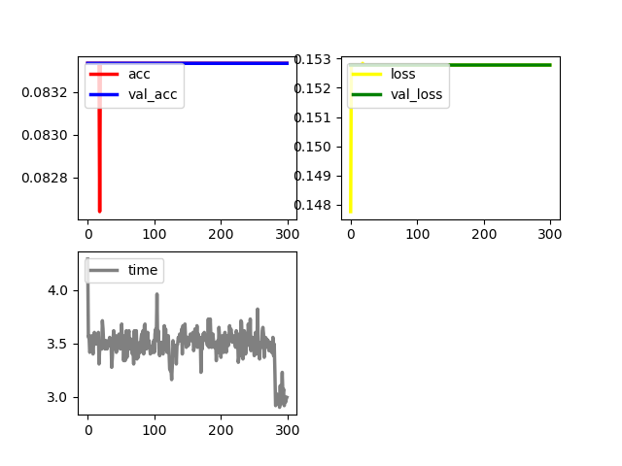
Schriftartenerkennung mit CNN
Model 5
Model 6

Slide 18
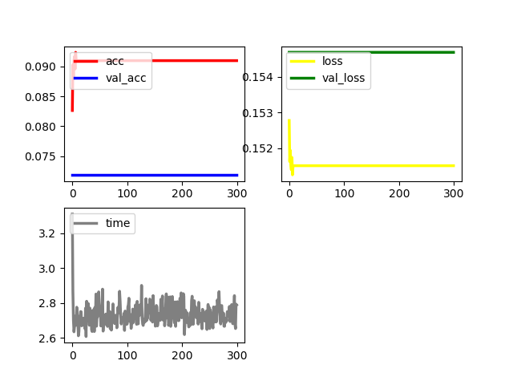
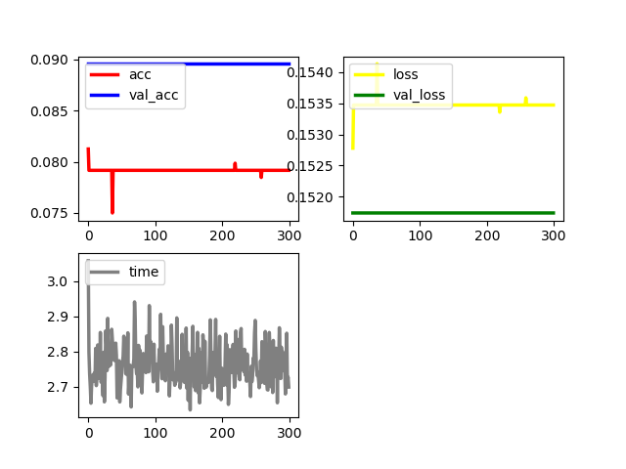
Schriftartenerkennung mit CNN
Model 7
Model 8

Slide 19
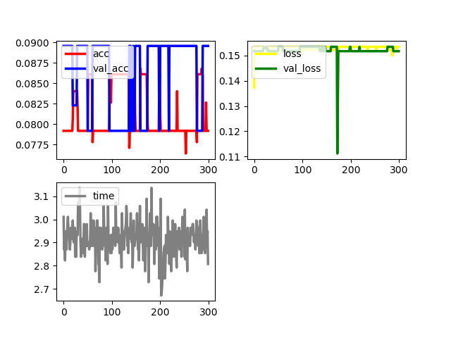
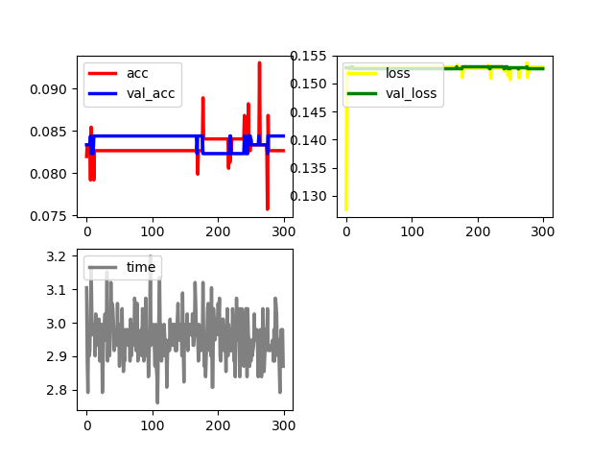
Schriftartenerkennung mit CNN
Model 9
Model 10

Slide 20
Schriftartenerkennung mit CNN
Neuronale Netze verhalten sich Sprunghaft
Nicht jedes Netz ist für jede Aufgabe geeignet
Kleine Änderungen haben große Auswirkungen
Manchmal ist der Zufall entscheidend
Die Genauigkeit steigt schnell oder gar nicht

